Slide 1
Where to choose a neighborhood in Seattle for a hotel investment?

Slide 2
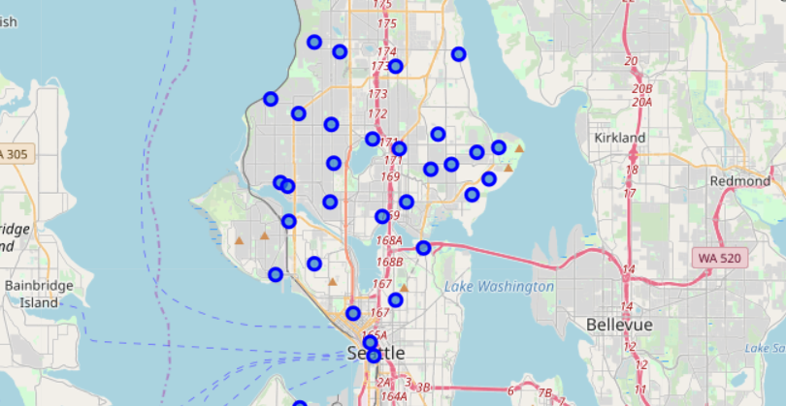

Slide 3
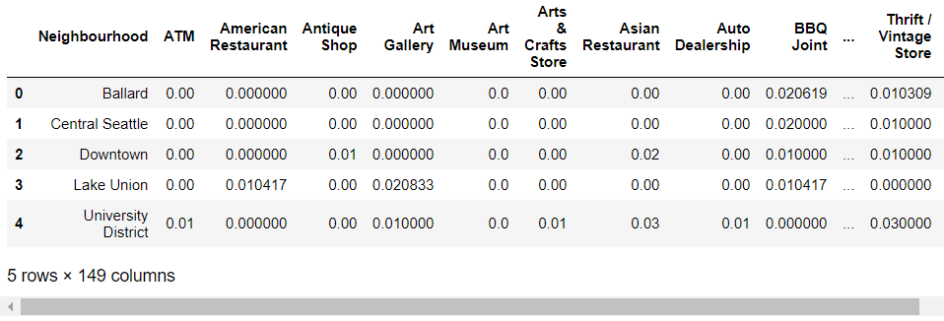
Six big neighborhoods in Seattle

Slide 4
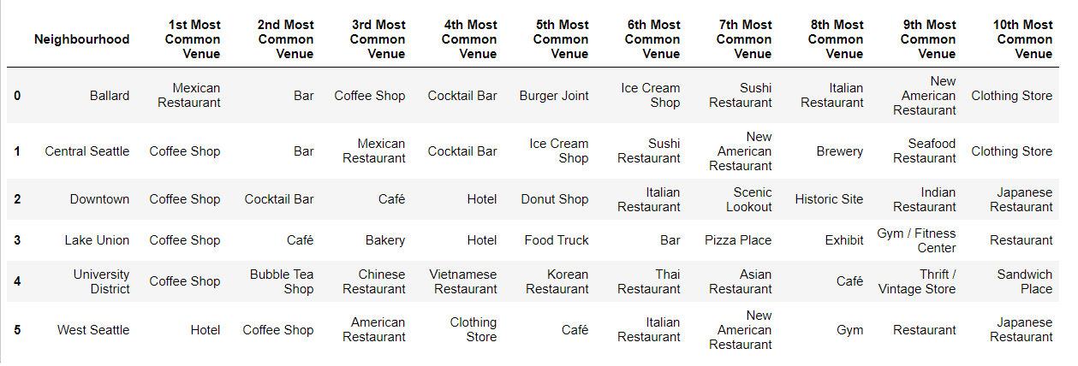
Ten most common venues

Slide 5
